Slide 1



RESERVOIR CHARACTERIZATION USING THE 3D SEISMIC DATA AND WIRELINE LOGS
SUBMITTED BY :
Aman Kumar (22MC0011)
2. Debajyoti Banerjee (22MC0037)
3. Nandan Mukherjee (22MC0057)
4. Sandipan Karmakar (22MC0077)
5. Saptashi Chatterjee (22MC0082)
Instructor: Prof. Saurabh Datta Gupta

Slide 2
OBJECTIVE
3D Seismic Data Visual Interpretation
Attribute Analysis (Structural, Stratigraphical, Strati-Structural)
Interpretation of Well Log Data
Identify Probable Reservoir Sections from Well Log Data
Estimation of Volumetrics Based on Estimated Fields
Developing a Sedimentary Model Based on our Understanding of Interpretation

Slide 3
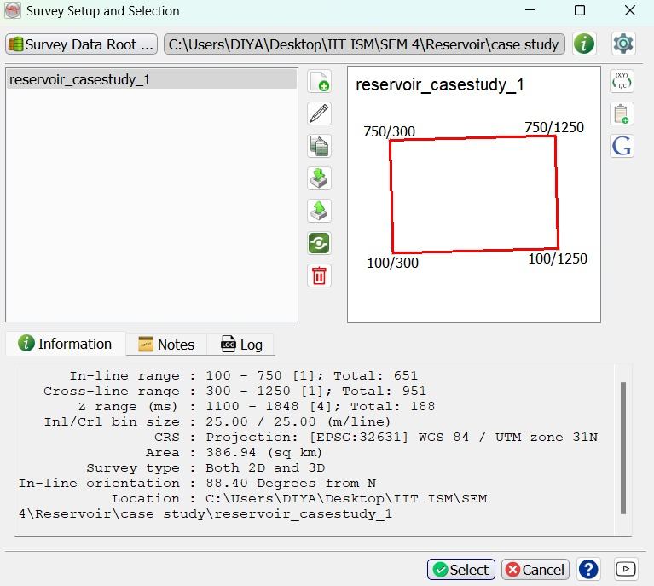
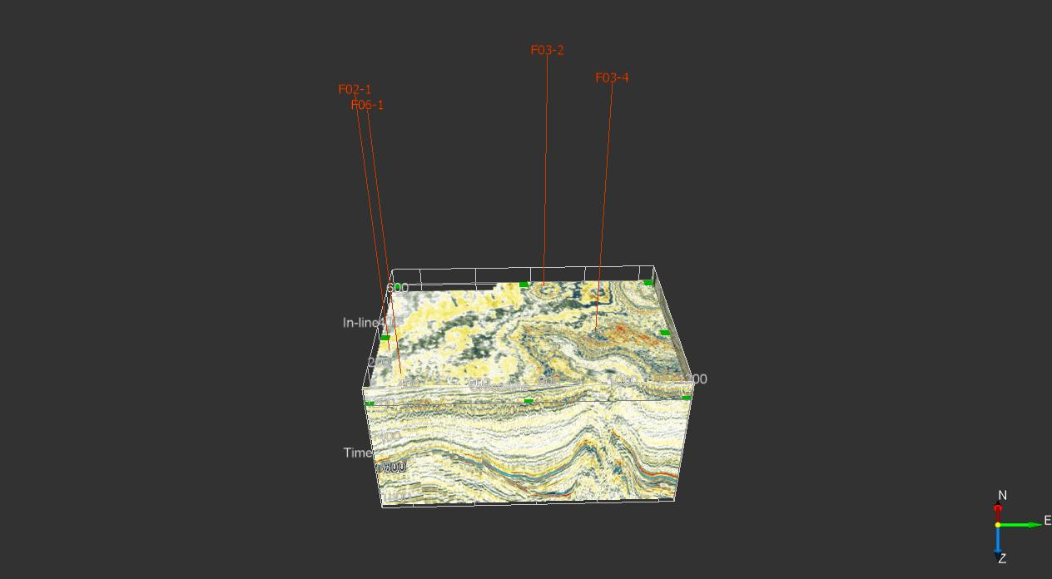
Wells and area location

Slide 4
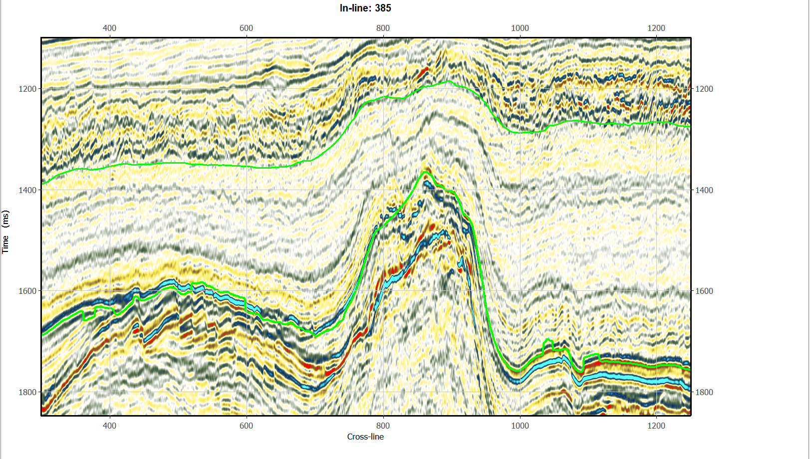
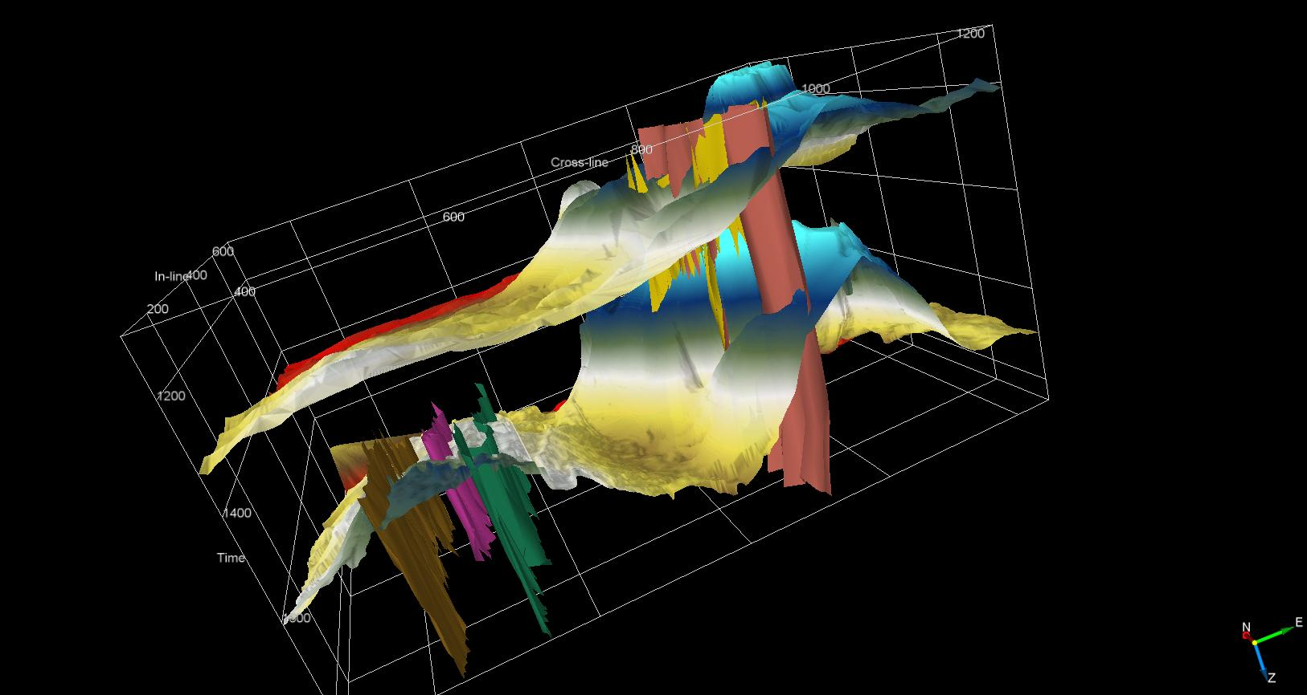
Horizon-1
Horizon-2
Fault plane

Slide 5
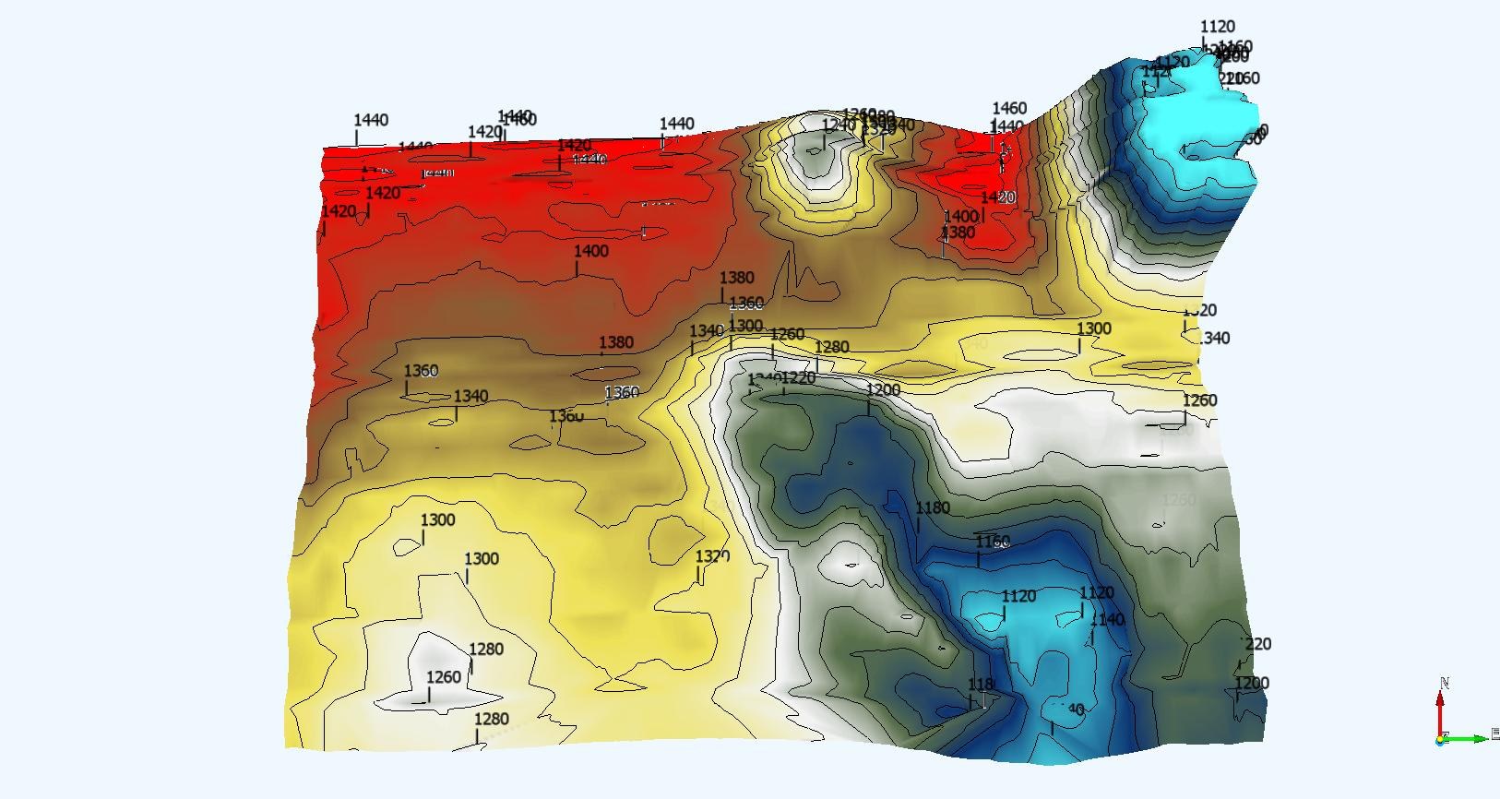
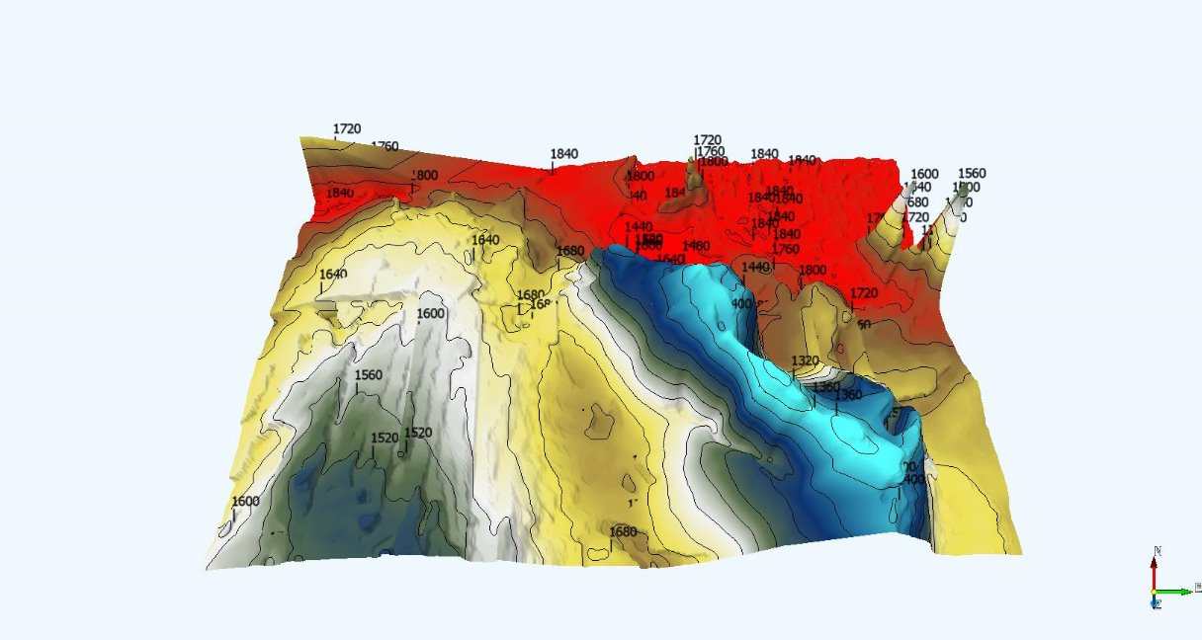
Horizon-1 (Time-contour)
Horizon-2 (Time-contour)

Slide 6
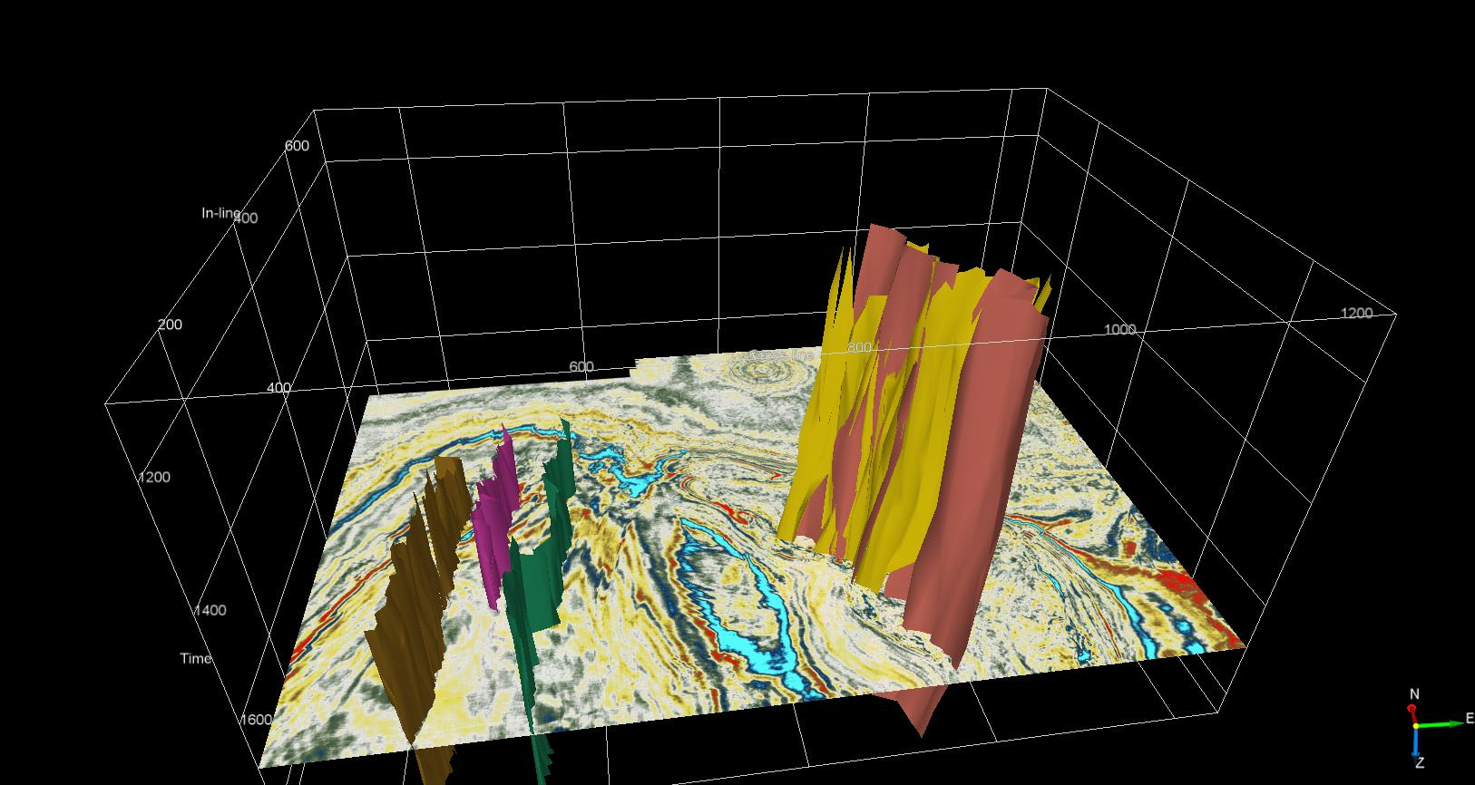
MAJOR & MINOR FAULTS

Slide 7
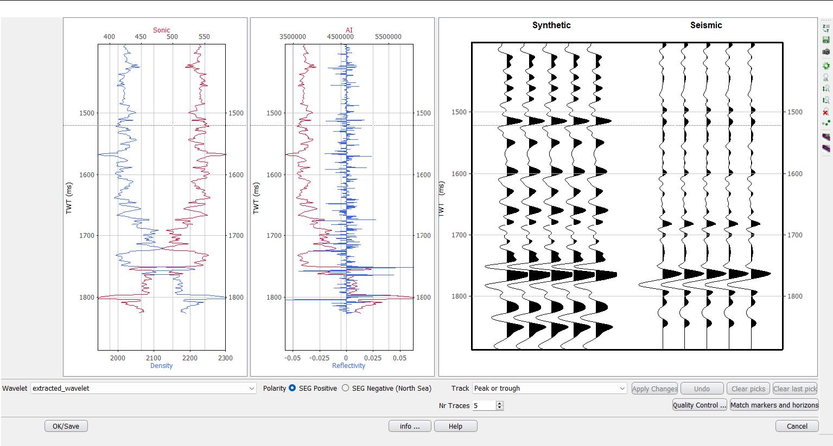
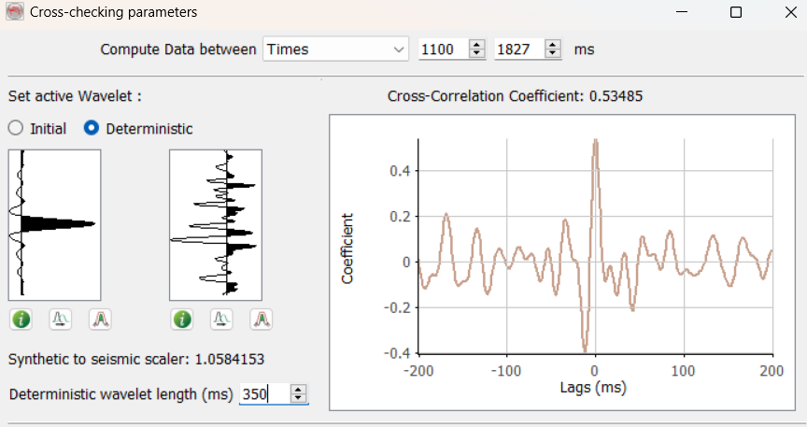
Well-To-Seismic-Tie

Slide 8
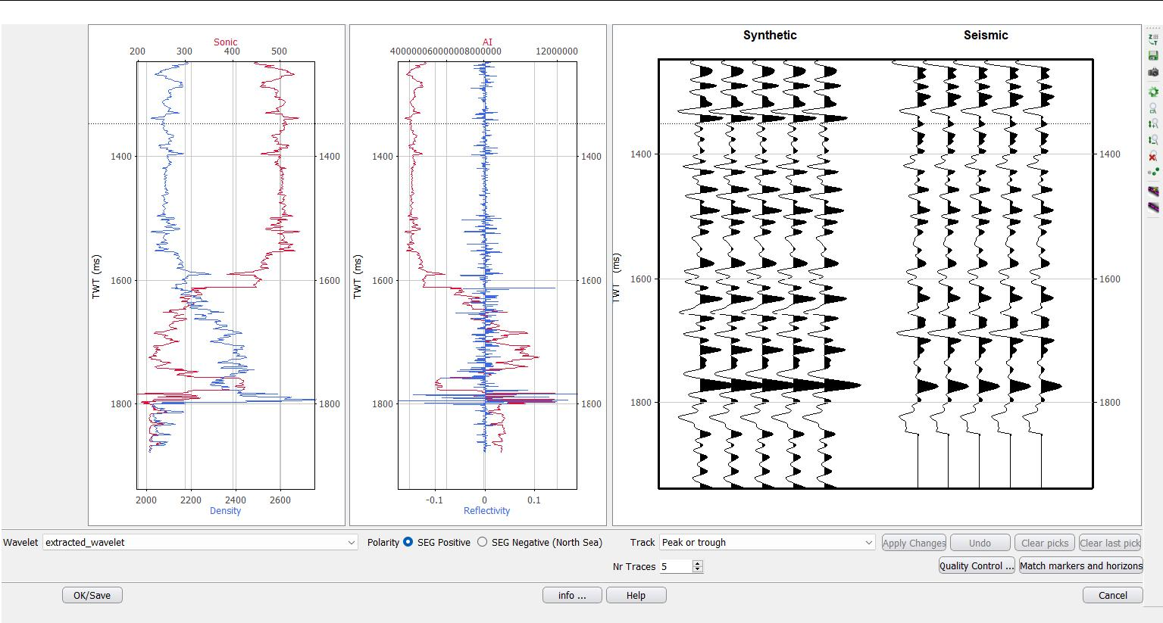
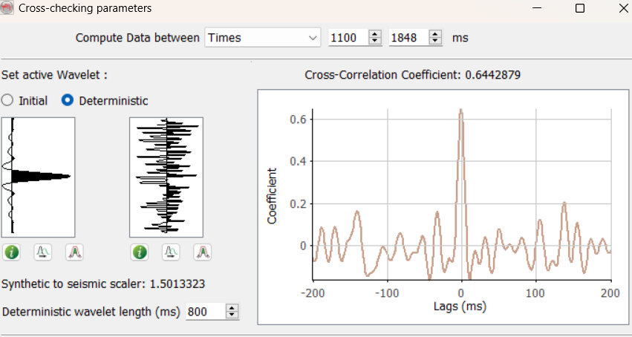
Well-To-Seismic-Tie

Slide 9
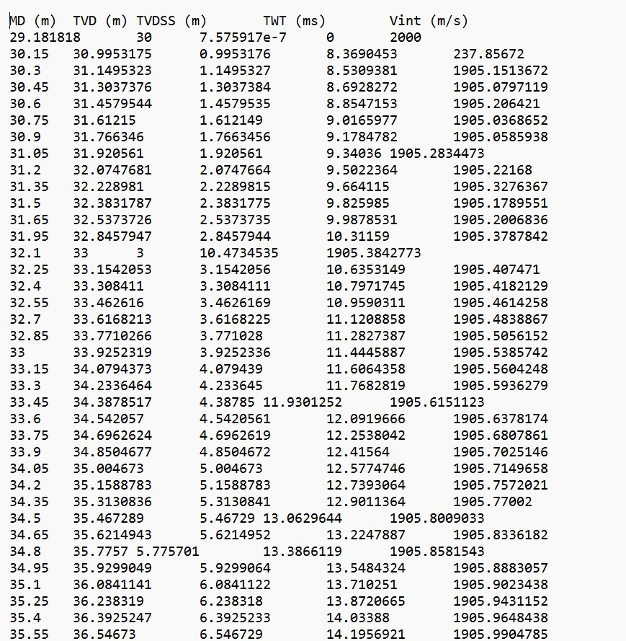
TIME-DEPTH MODEL

Slide 10
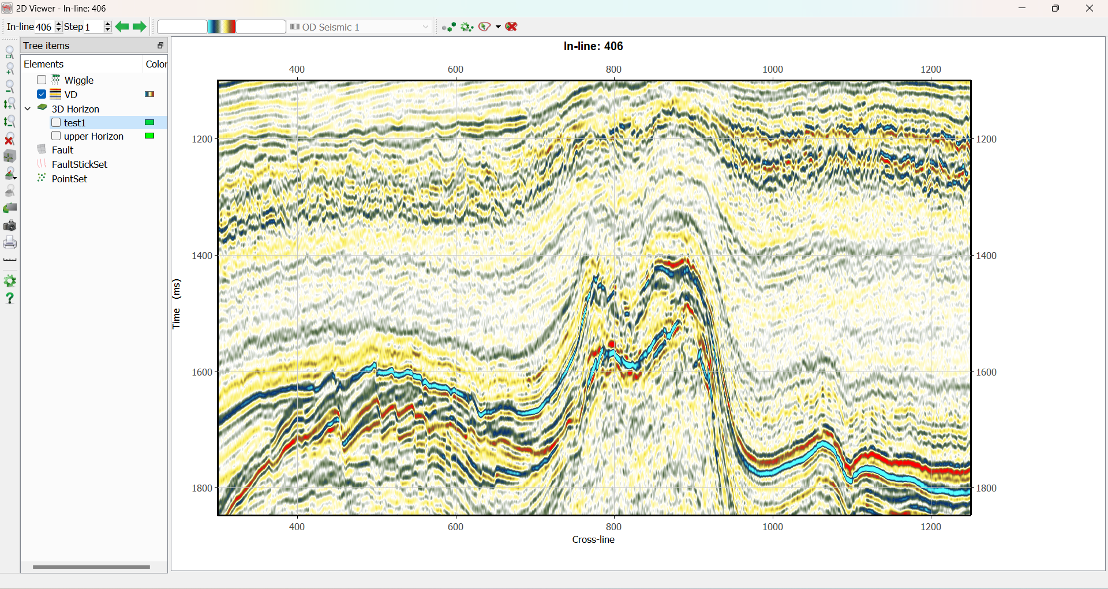
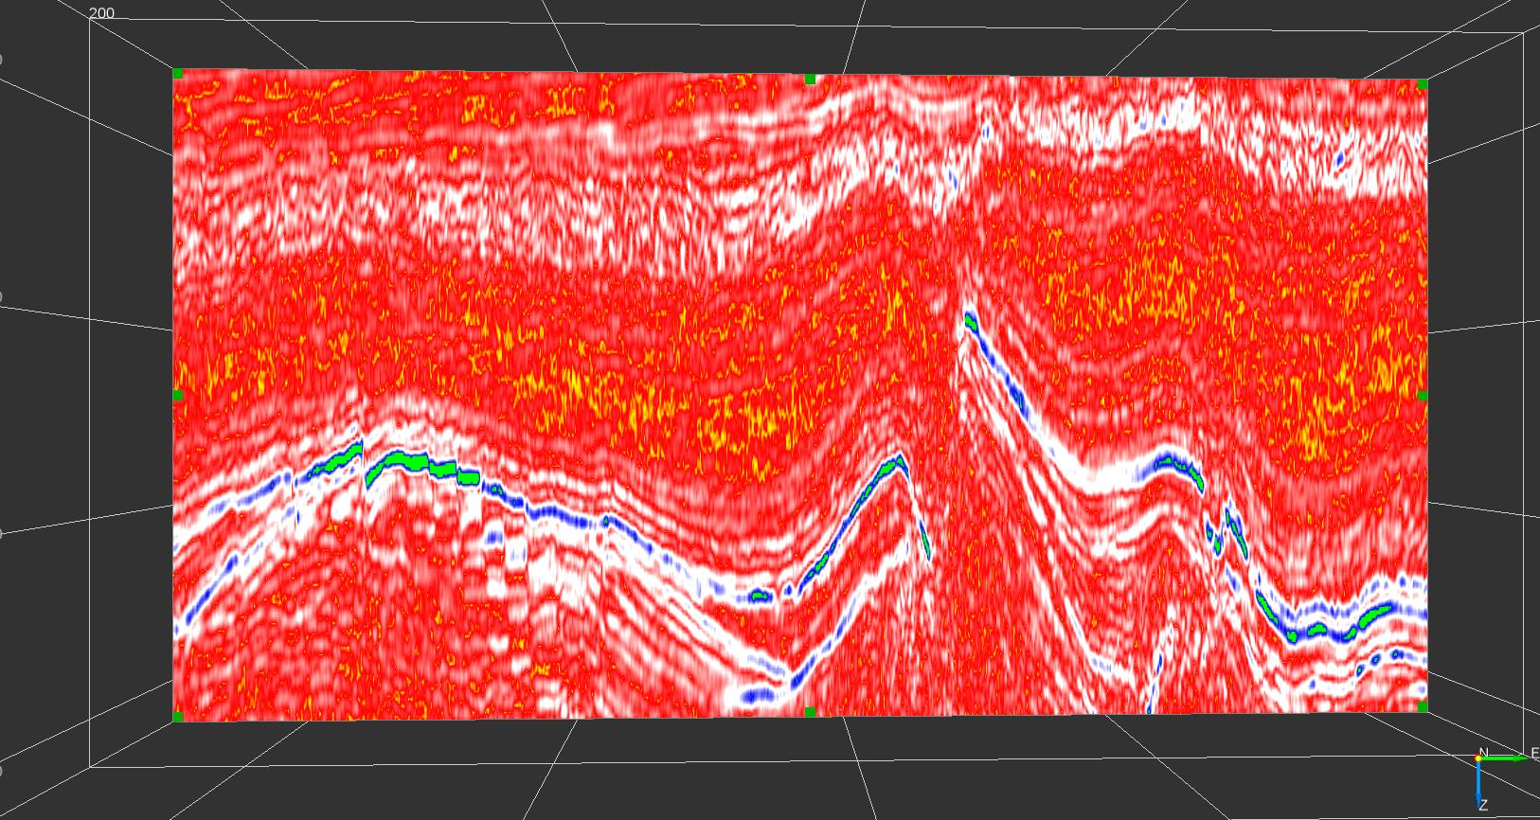
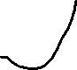
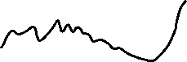


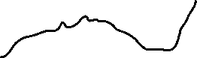
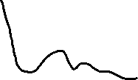



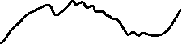

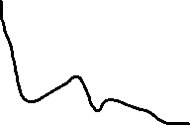

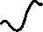

Seismic Interpretation: (Attribute analysis)
Amplitude anomaly
Instantaneous amplitude attribute co-rendered with original seismic section in the inline section
Inline 406 from the Original seismic data

Slide 11
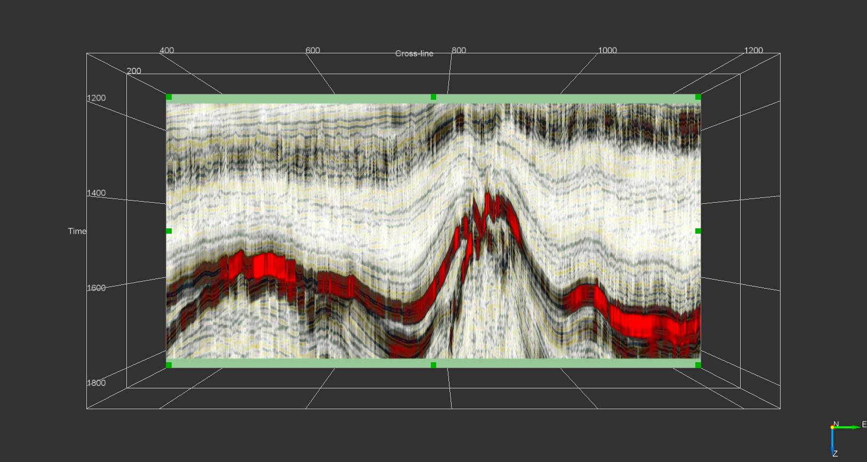
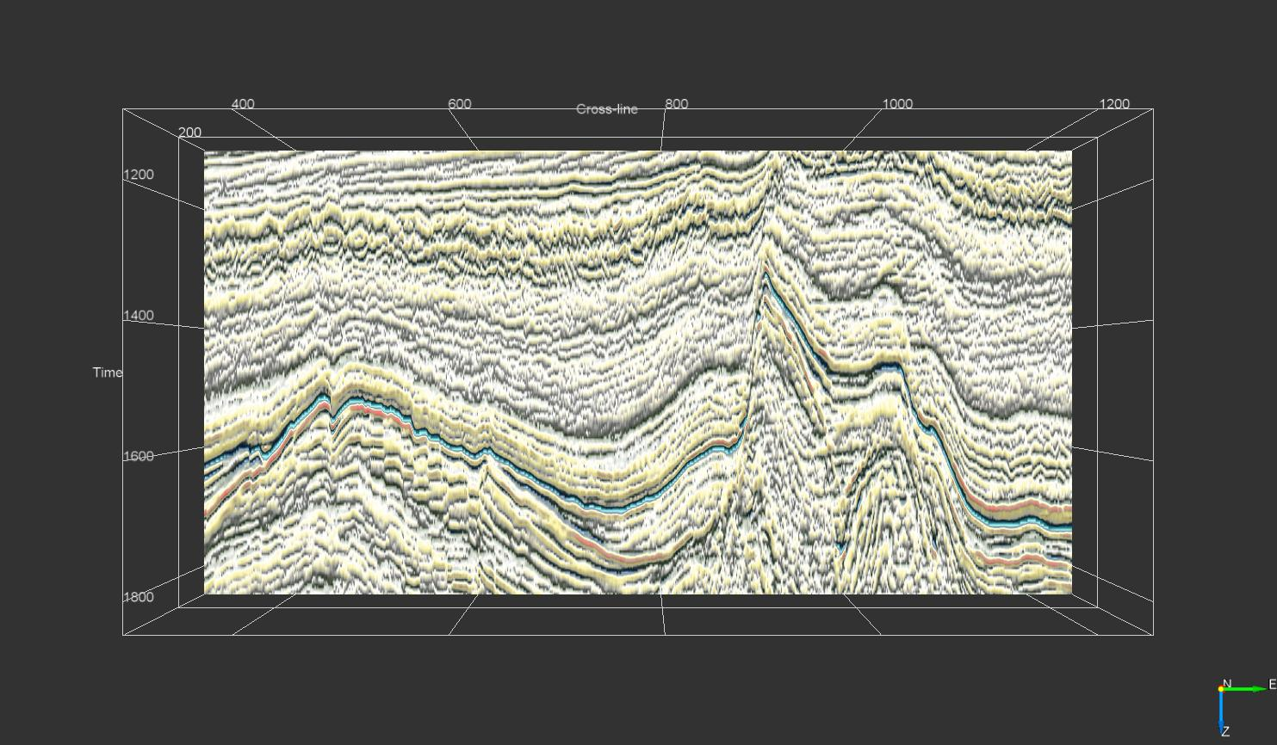
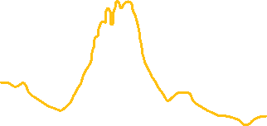
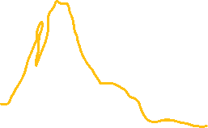





pos
High reflection strength
neg
Energy attribute co-rendered with original seismic section at inline-296
Instantaneous Phase attribute co-rendered with original seismic
The seismic attribute study bought out clearly the polygonal nature of these layer bound fault system

Slide 12
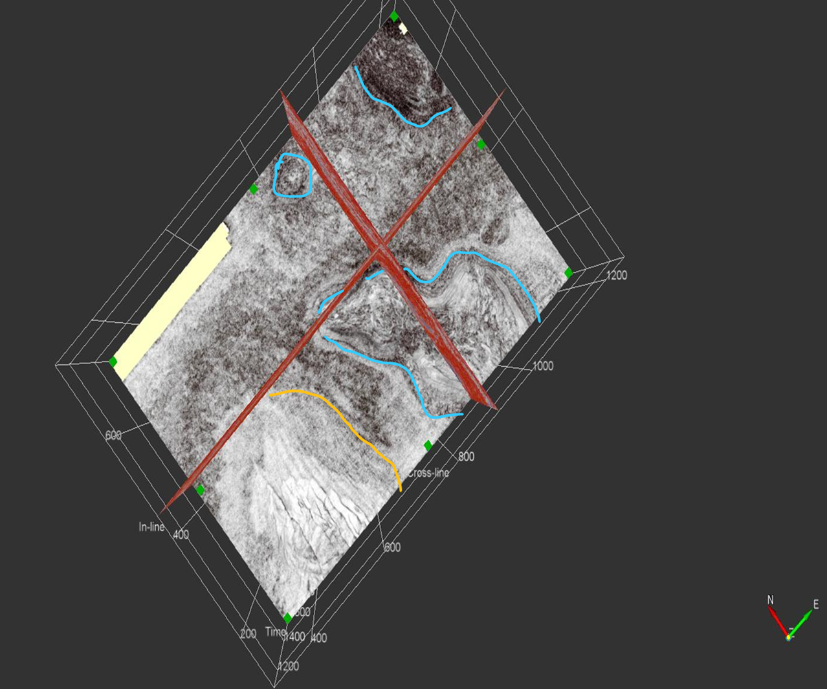
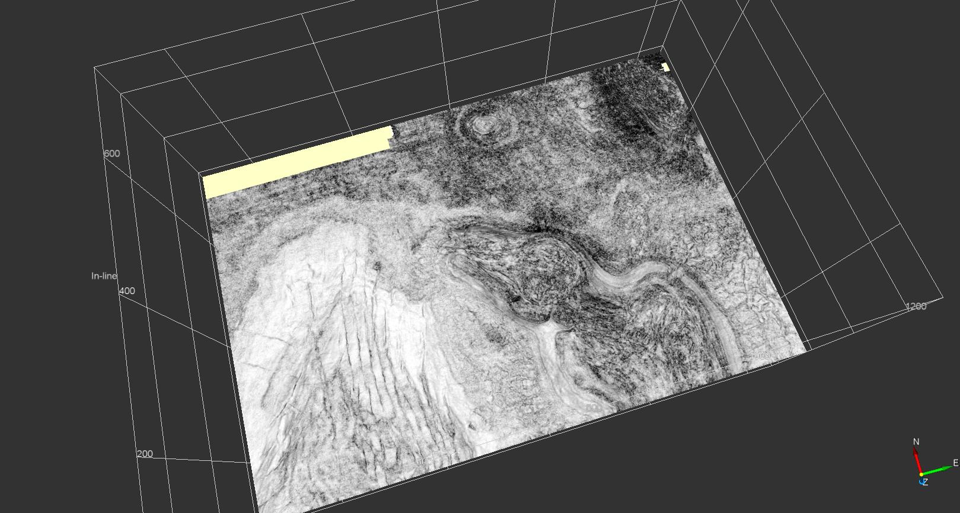
Both inline and crossline divides the whole z-slice[1.6 s] section into four parts:
1. N-E zone denotes high dissimilarity and denotes a salt diapir presence
2. N-W zone close to xline depicts another small salt-dome
3. In the middle portion along the south part major formation of salt dome.
4. S-W zone is deliberately denotes Polygonal fault system
At 1.6 seconds obtained from similarity volume using original volume as an input. The fault networks are characterized by low similarity.
Visualization of Polygonal Fault networks over Time slice at time t = 1.6 seconds

Slide 13
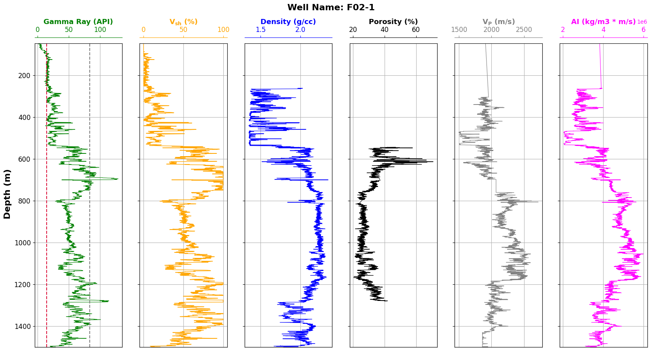
Well Data Interpretation

Slide 14
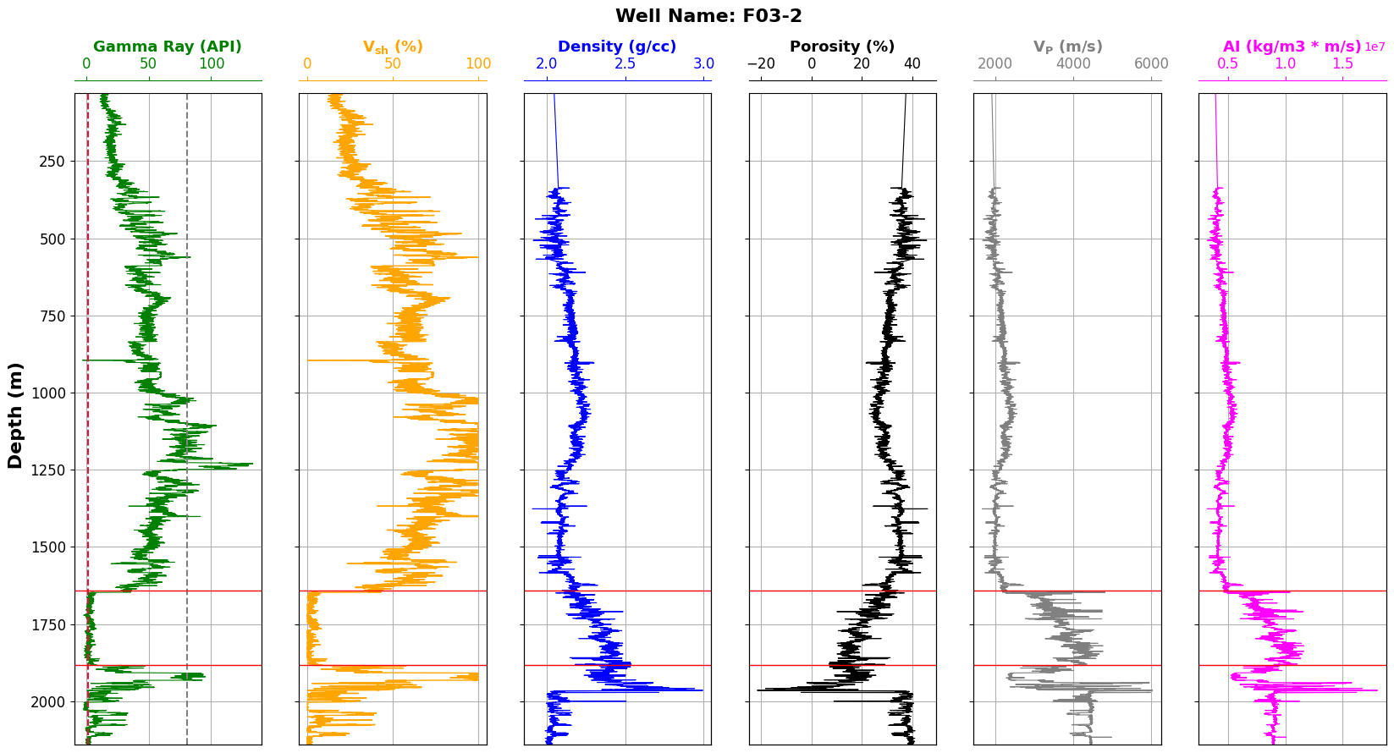
Well Data Interpretation

Slide 15
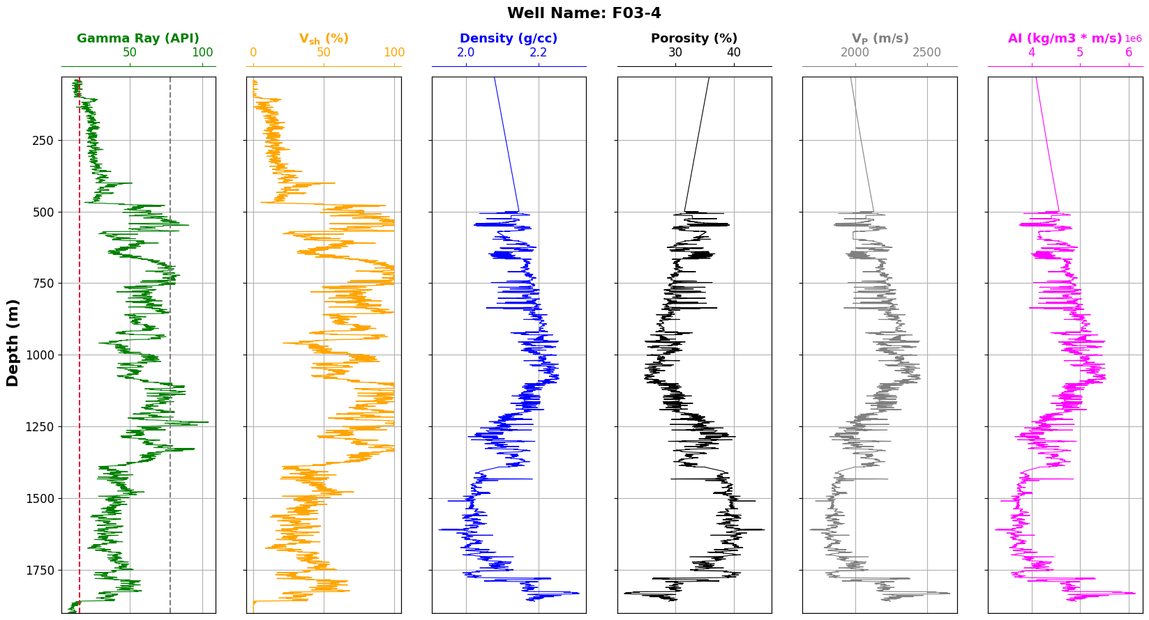
Well Data Interpretation

Slide 16
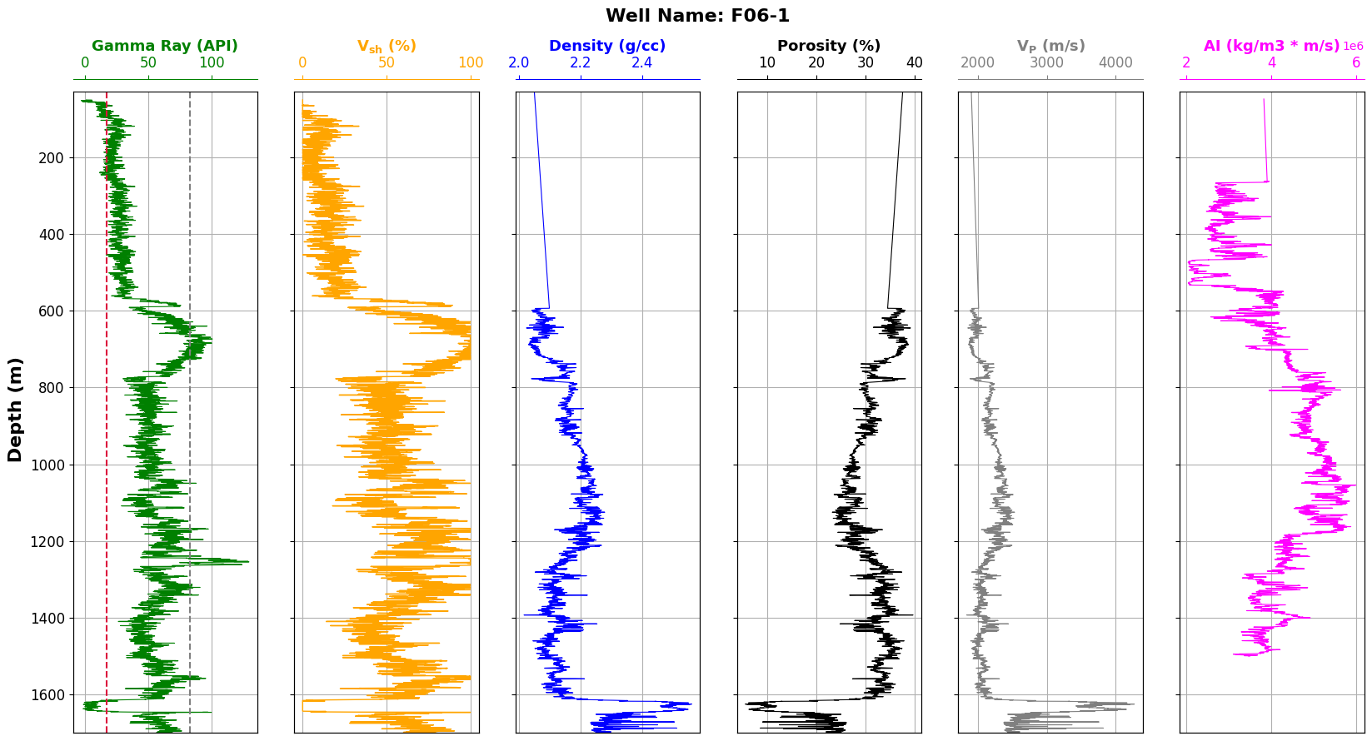
Well Data Interpretation

Slide 17
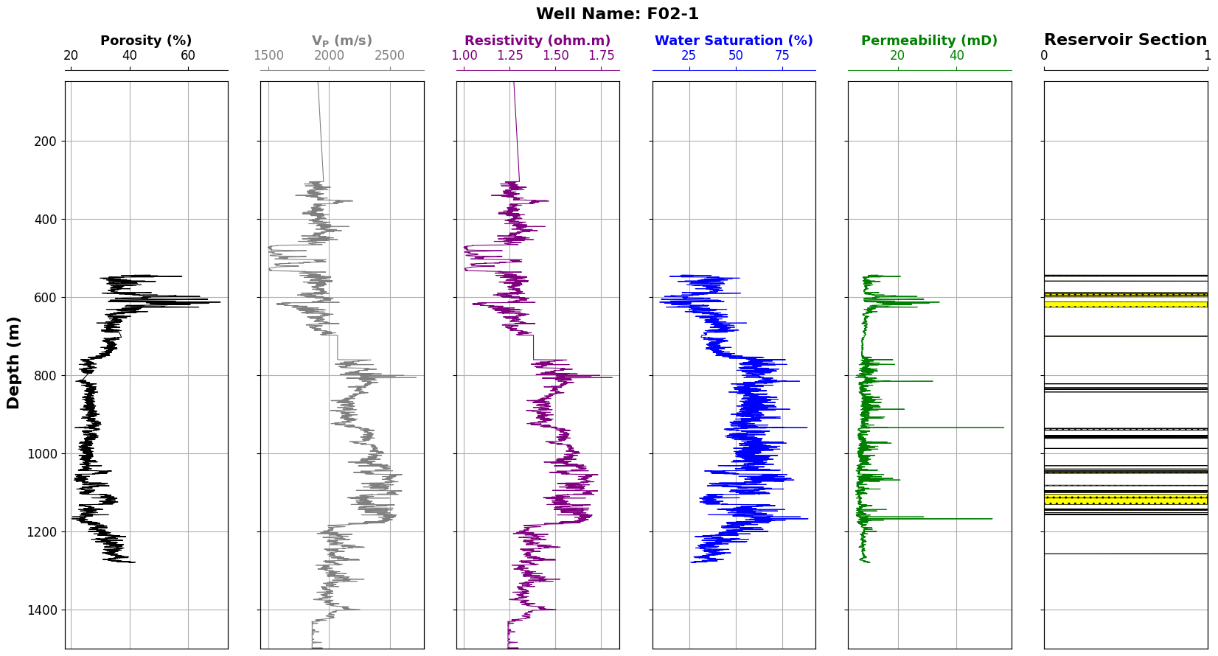
Estimation of Petrophysical Parameters & Reservoir Zonation

Slide 18
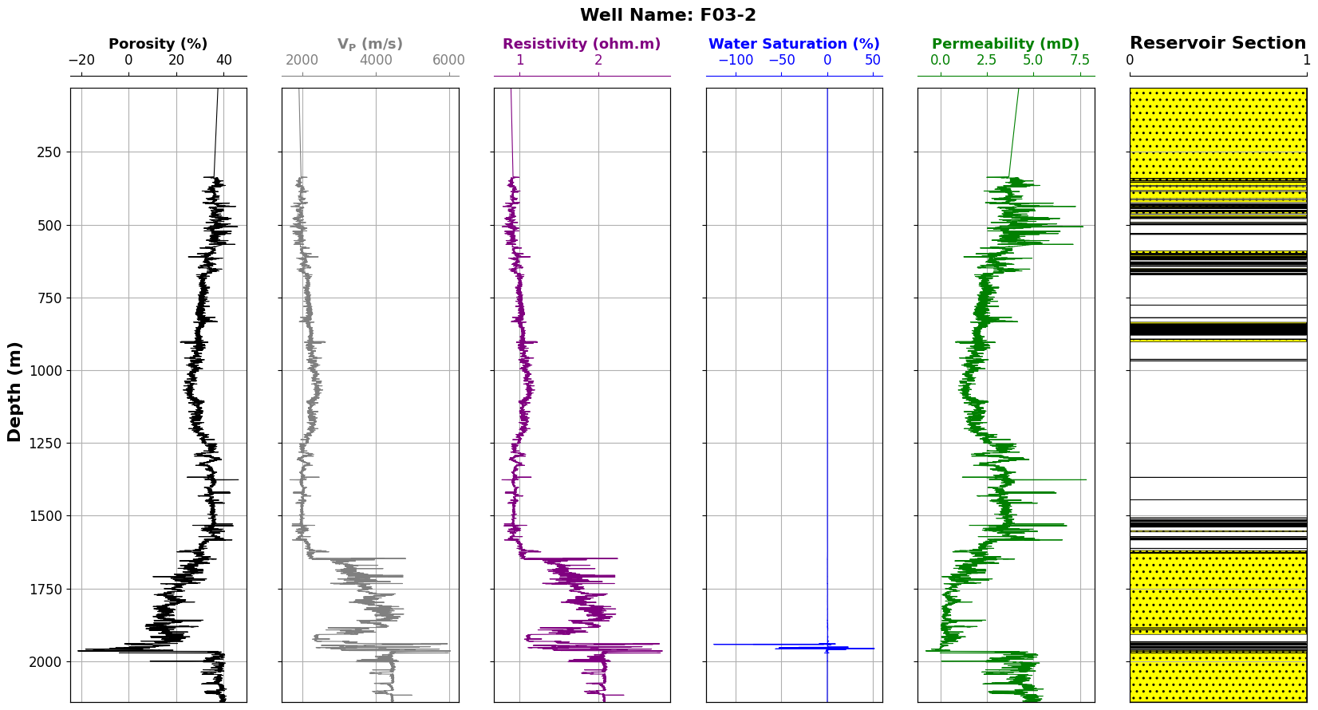
Estimation of Petrophysical Parameters & Reservoir Zonation

Slide 19
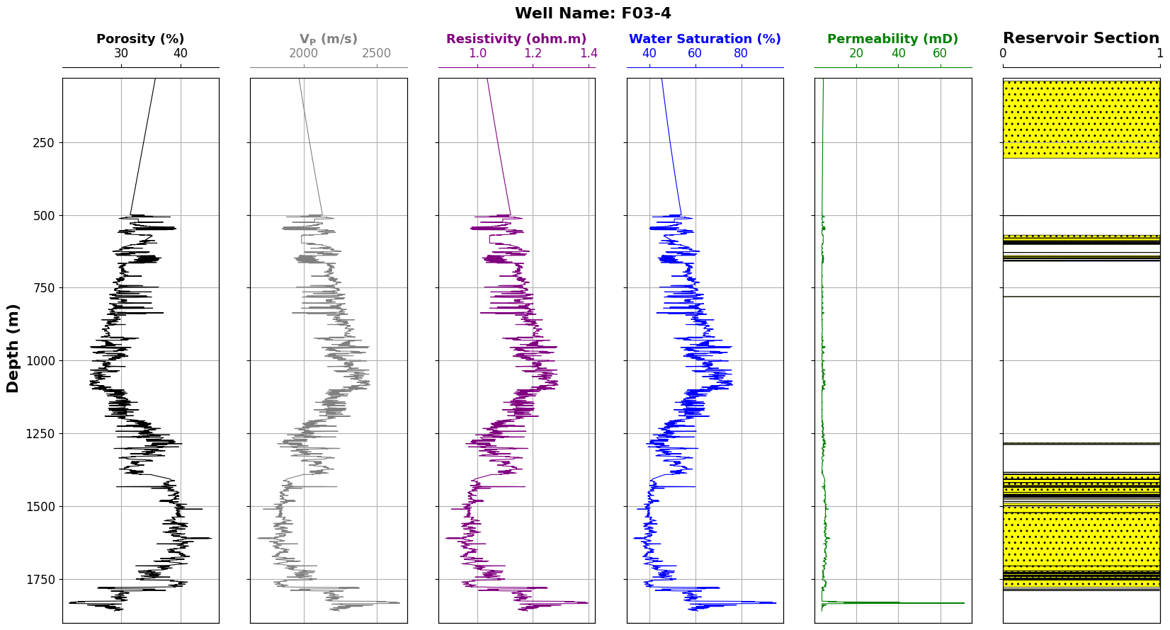
Estimation of Petrophysical Parameters & Reservoir Zonation

Slide 20
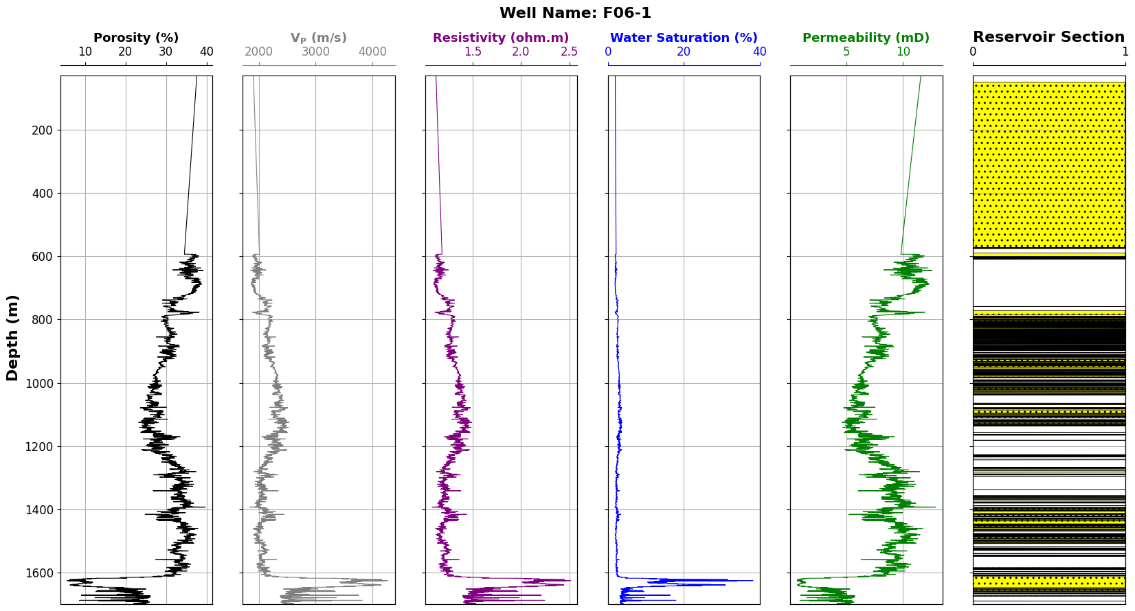
Estimation of Petrophysical Parameters & Reservoir Zonation

Slide 21
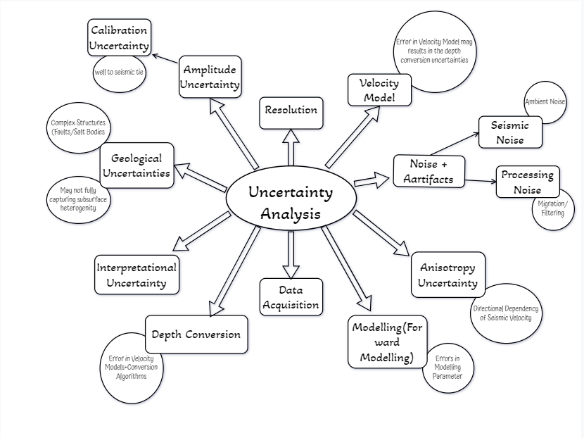
UNCERTAINTY ANALYSIS
Also, due to incorporation of emperical relations for the generation of Resistivity & Permeability Log and compuation of Petrophysical Parameters

Slide 22
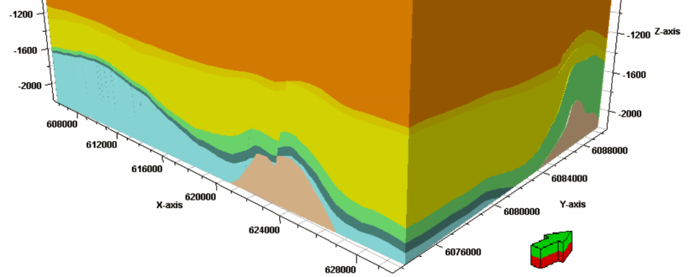
Development of Sedimentary Model :
Salt dome

Slide 23
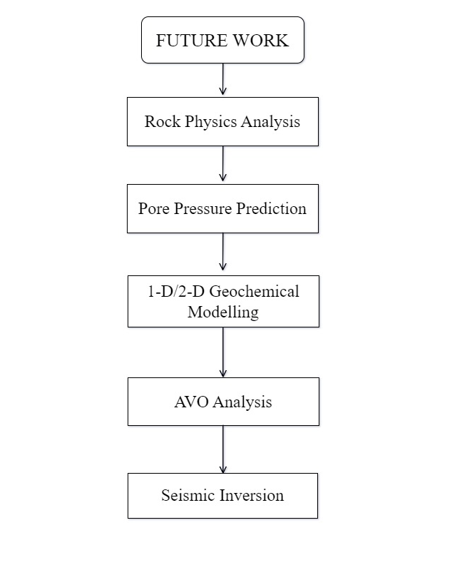
FUTURE WORK

Slide 24
CONTRIBUTION
Aman Kumar: Seismic Structural Interpretation and Well to Seismic Tie
Saptashi Chatterjee: Sequence Interpretation and attribute analysis
Debajyoti Banerjee: Well Log Data Interpretation
Nandan Mukherjee: Petrophysical Analysis and Reservoir Zonation
Sandipan Karmakar: Uncertainty Analysis and Presentation

Slide 25
THANK YOU

